Slide 1

Negative Testing
Table of contents
Introduction
what positive and negative testing is, how they’re different
Why do negative testing
Customers POV, organisations POV
Purpose
Benefits
Examples of positive and negative testing
Few negative testing techniques
Basic factors that help in Writing Positive and Negative tests

Slide 2
Introduction
Having the most optimal product quality is the primary goal of the test organizations.
With the help of an efficient quality assurance process, test teams attempt to find maximum defects during their testing, thereby ensuring that the client or the end user consuming the product does not see any abnormalities with respect to its functioning in their own computing environment.
Since finding defects is one of the main goals of a tester, he/she needs to carefully craft or design the test scenarios to make sure the particular application or product performs the way it is supposed to.
The entire testing effort can be basically generalized into two categories: positive testing paths and negative testing paths.

Slide 3
What positive and negative testing is, how they’re different
Positive testing
It is the process of running test scenarios that an end user would run for his use.
Positive testing entails running a test scenario with only correct and valid data. If a test scenario doesn’t need data, then positive testing would require running the test exactly the manner in which it’s supposed to run and hence to ensure that the application is meeting the specifications.
Sometimes there may be more than one way of performing a particular function or task with an intent to give the end user more flexibility or for general product consistency.
This is called alternate path testing which is also a kind of positive testing. In alternate path testing, the test is again performed to meet its requirements but using the different route than the obvious path.
The test scenario would even consume the same kind of data to achieve the same result.

Slide 4
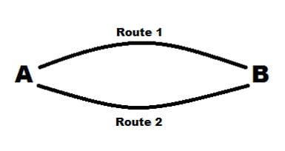
It can be diagrammatically understood from a very generic example described below:
A is a starting point and B is the endpoint. There are two ways to go from A to B. Route 1 is the generally taken route and Route 2 is an alternative route. Therefore in such a case, happy path testing would be traversing from point A to B using Route 1 and the alternative path testing would comprise taking Route 2 to go from A to B. Observe that the result in both the cases is the same.

Slide 5
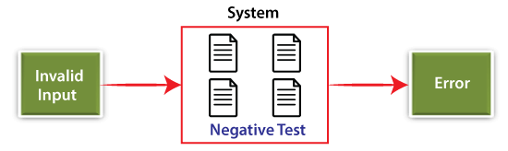
What is Negative Testing?
Negative testing is performed to ensure that the product or application under test does NOT fail when an unexpected input is given.
The purpose of Negative testing is to break the system and to verify the application response during unintentional inputs.

Slide 6

Example:
Say for example you need to write negative test cases about a pen. The basic motive of the pen is to be able to write on paper.
Some examples of negative testing could be:
Change the medium that it is supposed to write on, from paper to cloth or a brick and see if it should still write.
Put the pen in the liquid and verify if it writes again.
Replace the refill of the pen with an empty one and check that it should stop writing.
Example of Phone number

Slide 7
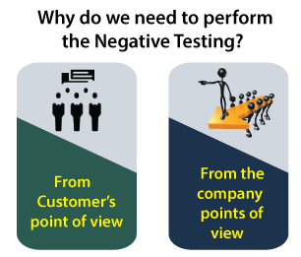
Why do Negative Testing?
Subsequently, performing any type of testing activity is a cost and time-taking process. So, we have to select sensibly whether we need to implement the negative testing in our system or not.
Here, we are discussing why we need to perform negative testing in the particular application by considering the following preservatives of clients, organizations.

Slide 8
From Customer's point of view
The Implementation of negative testing make sure to delivers a bug-free and zeroes vulnerability product in order to meet the Customer's expectation.
Negative testing is needed when the application is crucial such as e-commerce, online stock, and so on.
The cost is the only concern to the client while performing the negative testing. But when the effect is evaluated, it is up to the client to choose whether to perform negative testing or not.
From the company's point of view
To deliver a good quality product to its customer is the responsibility of the organization. And to accomplish this, one has to perform negative testing.
From a company's point of view, the negative testing needs to be performed because of validation against a failure.
We should perform the negative testing because sometimes, we cannot guarantee to develop a 100% bug-free system, but we have to ensure that everything is done to avoid a failure.
By performing the negative testing, we can also cover the vital cases of hacking since there are many hackers out there who are looking for a chance to destroy the system.

Slide 9
Purpose of negative testing
The purpose of negative testing is to prevent the application from crashing and it also helps improve the quality of an application by detecting defects.
Negative testing helps you to improve the testing coverage of the application.
Negative testing makes the application more stable and reliable.
Negative testing together with positive testing allows users to test the application with any valid (or invalid) input data.

Slide 10
Benefits of negative testing
Negative testing is done to check that the product deals properly with the circumstance for which it is not programmed. The fundamental aim of this testing is to check how bad data is taken care of by the systems, and appropriate errors are shown to the client when bad data is entered. Both positive and negative testing play an important role. Positive testing ensures that the application does what it is implied for and performs each function as expected. Negative testing is opposite of positive testing. Negative testing discovers diverse approaches to make the application crash and handle the crash effortlessly.
Example:
If there is a text box that can only take numeric values but the user tries to type a letter, the correct behaviour would be to display a message such as (Incorrect data) Please enter a number.
If the user is to fill the name field and there are ground rules that the name text is mandatory to fill, but that the name box shouldn't have values other than letters (no numeric values and special characters). Negative test cases could be a name containing numeric values or special characters. The correct behaviour of the system would be to not display those invalid characters.

Slide 11
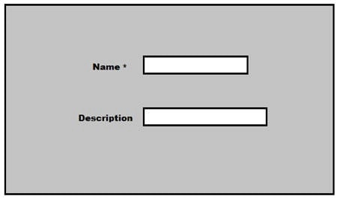
Practical Examples of positive and negative testing
Let’s take an example of a UI wizard to create some policies. In the wizard, the user has to enter textual values in one pane and numerical values in another.
First pane:
In the first one, the user is expected to give a name to the policy as shown below:
Let’s also get some ground rules to make sure we design good positive and negative scenarios.
Requirements:
The name text box is a mandatory parameter
The description is not mandatory.
The name box can have only a-z and A-Z characters. No numbers, special characters are allowed.
The name can be maximum 10 characters long.

Slide 12
Now let’s get to design the positive and negative testing cases for this example.
Positive test cases: Below are some positive testing scenarios for this particular pane.
ABCDEFGH (upper case validation within character limit)
abcdefgh lower case validation within character limit)
aabbccddmn (character limit validation)
aDBcefz (upper case combined with lower case validation within character limit)
.. and so on.
Negative test cases: Below are some negative testing scenarios for this particular pane.
ABCDEFGHJKIOOOOOKIsns (name exceeding 10 characters)
abcd1234 (name having numerical values)
No name supplied
sndddwwww_ ( the name containing special characters)
.. and so on.

Slide 13
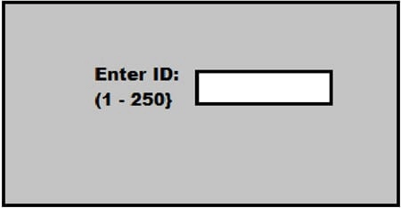
Second pane:
In the second pane, the user is expected to put in only numerical values as shown below:
Let’s establish some ground rules here as well:
Requirements:
The ID has to be a number between 1- 250
The ID is mandatory.
Therefore here are some positive and negative test scenarios for this particular pane.
Positive test scenarios: Below are some positive testing scenarios for this particular pane.
12 (Entering a valid value between the range specified)
1,250 (Entering the boundary value of the range specified)
Negative test scenarios: Below are some negative testing scenarios for this particular pane.
Ab (Entering text instead of numbers)
0, 252 (Entering out of boundary values)
Null input
-2 (Entering out of range values)
+56 (Entering a valid value prefixed by a special character)

Slide 14
Negative Testing Techniques
The following are the negative testing techniques adopted during software testing:
Embed Single Quote on URL when it tries to query the database.
Skip the Required Data Entry and try to proceed.
Verify each Field Type Test.
Enter large values to test the size of the fields.
Verify the numeric boundary and numeric size test.
Verify the Date Format and its validity.
Verify the web session and check for the performances.

Slide 15
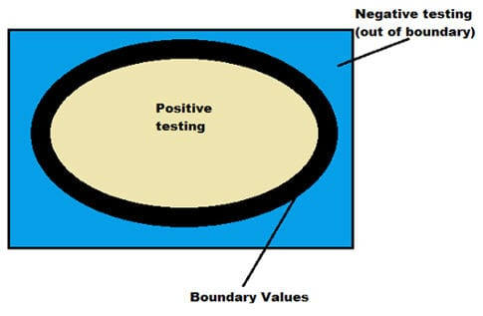
Basic factors that help in Writing Positive and Negative tests
If you closely observe the examples above, you will notice that there can be multiple positive and negative scenarios. However effective testing is when you optimize an endless list of positive and negative scenarios in such a way that you achieve sufficient testing.
Also, in both these cases, you will see a common pattern on how the scenarios are devised. In both the cases above, there are two basic parameters or techniques that formed a basis for designing sufficient amount of positive and negative test cases.
The two parameters are:
Boundary Value Analysis
Equivalence Partitioning
Boundary Value Analysis:
As the name itself implies, boundary indicates limits to something. Hence this involves designing test scenarios that only focus on the boundary values and validate how the application behaves. Therefore if the inputs are supplied within the boundary values then it is considered to be positive testing and inputs beyond the boundary values is considered to be a part of negative testing.
For example, if a particular application accepts VLAN Ids ranging from 0 – 255. Hence here 0, 255 will form the boundary values. Any inputs going below 0 or above 255 will be considered invalid and hence will constitute negative testing.

Slide 16
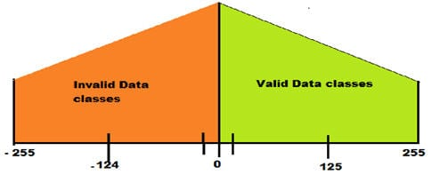
Equivalence Partitioning:
In Equivalence partitioning, the test data are segregated into various partitions. These partitions are referred to as equivalence data classes. It is assumed that the various input data (data can be a condition) in each partition behave the same way. Hence only one particular condition or situation needs to be tested from each partition as if one works then all the others in that partition is assumed to work. Similarly, if one condition in a partition doesn’t work, then none of the others will work.
Therefore it’s now very apparent that valid data classes (in the partitions) will comprise of positive testing whereas invalid data classes will comprise of negative testing.
In the same VLAN example above, the values can be divided into say two partitions.
So the two partitions here would be:
Values -255 to -1 in one partition
Values 0 to 255 in another partition

Slide 17
Negative testing improves the testing coverage of your application. Using the negative and positive testing approaches together allows you to test your applications with any possible input data (both valid and invalid) and can help you make your application more stable and reliable.

